Slide 1
Machine Learning Models: a hands-on experience
(this is just a teaser trailer!)
Gabriele Bonomi Boseggia, Fabio Colombo, Luca Mammi
Milan, April 19th, 2018

Slide 2
Follow the link!
http://beta.mybinder.org/v2/gh/gbonomib/mlTeachings/master?filepath=0_teaser.ipynb?urlpath=tree

Slide 3
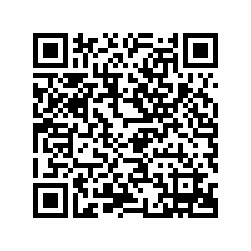
If you only have your phone, take a pic of the QR code

Slide 4
Or simply open this

